Slide 1

EDA
GROUP 5
VIDEO GAME SALES

Slide 2

INTENDED FOR:
Entrepreneurs that are interested in setting up a game shop
Companies that want to develop video games
Companies that want to develop a gaming platform

Slide 3

HYPOTHESIS
How popular a product is in a specific period of time and geographical space, correlates with its demand by consumers.
Increase in demand by consumers, results in increase in profit earned by a marketing body
As such popularity of a product sold by a marketing body can result in an increase in profits

Slide 4
DATA DESCRIPTION
Has 16,599 tuples
Has 11 Fields or attributes which includes:

Slide 5

DATA DESCRIPTION - FIELDS
Rank - Ranking of Overall(Global) sales
Name - The Game’s name
Platform - Platform compatible with the game
Year - Year of the game's release
Genre - Genre of the game
Publisher - Publisher of the game
This Photo by Unknown author is licensed under CC BY.

Slide 6

DATA DESCRIPTION - FIELDS
NA_Sales - Sales in North America (in millions)
EU_Sales - Sales in Europe (in millions)
JP_Sales - Sales in Japan (in millions)
Other_Sales - Sales in the rest of the world (in millions)
Global_Sales - Total worldwide sales.
This Photo by Unknown author is licensed under CC BY.

Slide 7
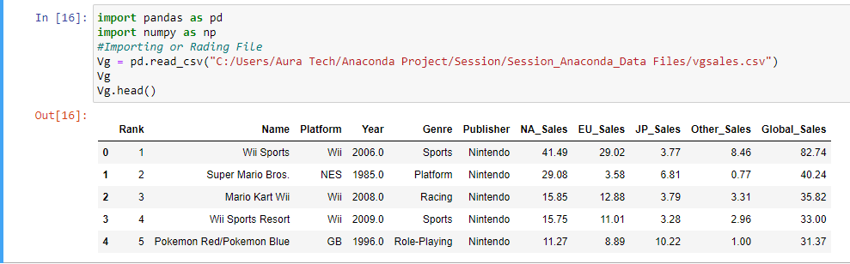

Slide 8

DATA DESCRIPTION – RELIABILITY
Presence of Null Values
Absence of Duplicates
As such, Data Set was fairly good for Analysis

Slide 9

QUESTION
Testing our Hypothesis

Slide 10

In a given period of time, Does Global Sales depend on Popularity of a Gaming Specification

Slide 11

DEPENDENCIES
Which attributes were employed in our analysis
This Photo by Unknown author is licensed under CC BY-SA-NC.

Slide 12

GAMING SPECIFICATIONS
Genre : What is the Type of the Game
Platform : Which Hardware supports the gaming environment
Publisher: Which Organization released the Game
This Photo by Unknown author is licensed under CC BY-NC.

Slide 13

YEAR
In the Attribute Year, in our Data Set, Values ranged from 1980 to 2020
Also there were Null Values Present
The Data Set was Filtered based on Year Groupings, such Groupings includes:
From 1980 – 1999, termed as 20th Century
From 2000 – 2020, Termed as 21st Century
All Null Values. Termed as Unknown Years

Slide 14

ANALYSIS
How do we employ our dependencies in testing the hypothesis
This Photo by Unknown author is licensed under CC BY.

Slide 15

POPULARITY IN EACH YEAR GROUPING
Based on Plaforms
Based on Genre
Based on Publisher

Slide 16

AVERAGE OVERALL(GLOBAL) SALES IN EACH YEAR GROUPING
Based on Plaforms
Based on Genre
Based on Publisher

Slide 17

ASSUMPTION
What conditions did we set for proving the hypothesis
This Photo by Unknown author is licensed under CC BY-NC.

Slide 18

What to Expect
4 Most popular Genres, Platform, and Publisher in each year groupings – out of which the most popular in each specification is singled out
4 Most Highest Average_Overall_Sales made according to Genre, Platform, Publisher in each Year Groupings – out of which the highest in each specification is singled out
As such, 6 deductions will be made in each year grouping, making it a total of 18 deduction in all year groupings

Slide 19

WHAT TO EXPECT – DIAGRAMMATIC REPRESENTATION
Year Grouping | Genre |  | Publisher |  | Platform
 | H.P | H.A.O.S | H.P | H.A.O.S | H.P | H.A.O.S
20th Century
21st Century
Unknown Years
H.P– Highest Popularity H.A.O.S –Highest Average Overall Sale

Slide 20

ASSUMPTION– DIAGRAMMATIC REPRESENTATION
Year Grouping | Genre |  | Publisher |  | Platform
 | H.P | H.A.O.S | H.P | H.A.O.S | H.P | H.A.O.S
20th Century
21st Century
Unknown Years
– Correlated Instances – Uncorrelated Instances

Slide 21

PLATFORM AND LIBRARIES
Python IDE (Jupyter Notebook)
Pandas
Matplotlib
Seaborn
This Photo by Unknown author is licensed under CC BY-SA-NC.

Slide 22

PROCESSES
Cleaning the Data – We changed all Null Values to 0
Filtering – We filtered the Data Sets based on our Year Groupings
Proceeded with our Analysis
Visualized our Analyzed Data

Slide 23
VISUALIZATION
A Summary of everything analyzed
This Photo by Unknown author is licensed under CC BY.

Slide 24

POPULARITY
20th Century
This Photo by Unknown author is licensed under CC BY-SA-NC.

Slide 25
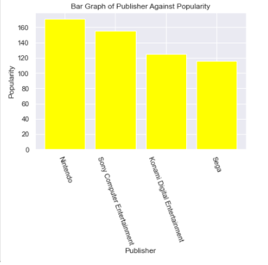
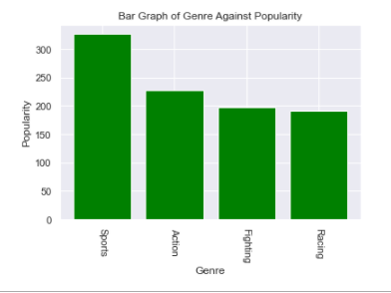
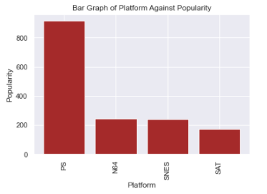
Publisher
Genre
Platform

Slide 26

AVERAGE OVERALL SALES
20th Century
This Photo by Unknown author is licensed under CC BY-SA-NC.

Slide 27
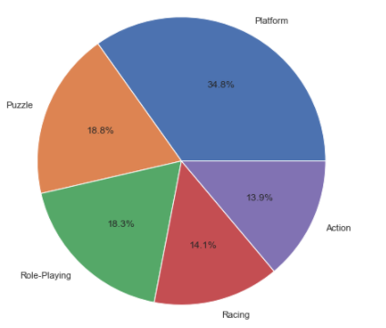
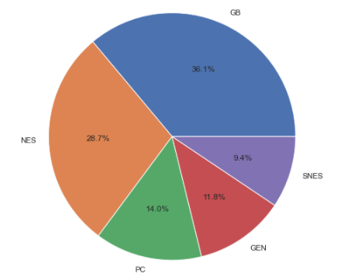
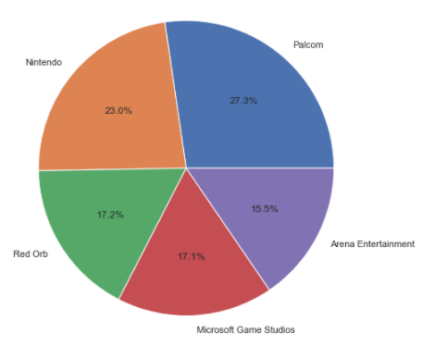
Genre
Platform
Publisher

Slide 28
POPULARITY 21st Century
This Photo by Unknown author is licensed under CC BY-SA-NC.

Slide 29
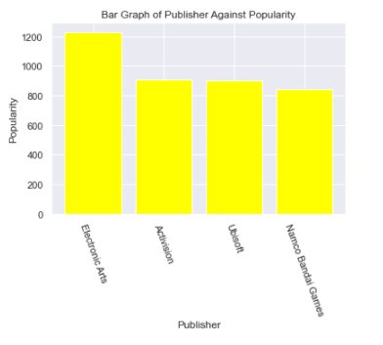
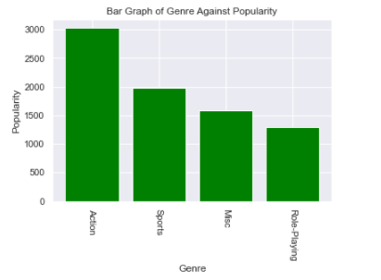
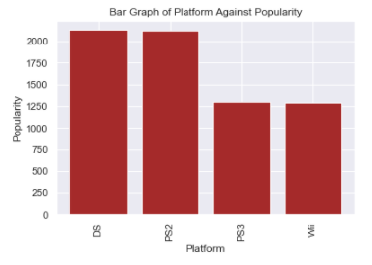
Publisher
Genre
Platform

Slide 30
AVERAGE OVERALL SALES
21st Century
This Photo by Unknown author is licensed under CC BY-SA-NC.

Slide 31
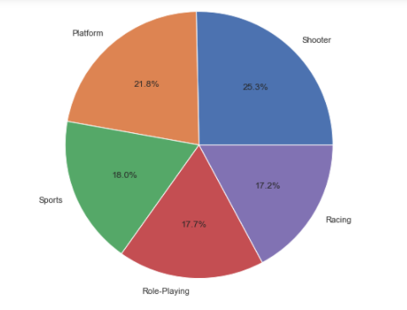
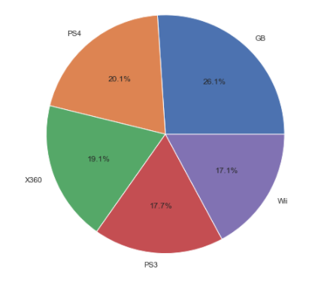
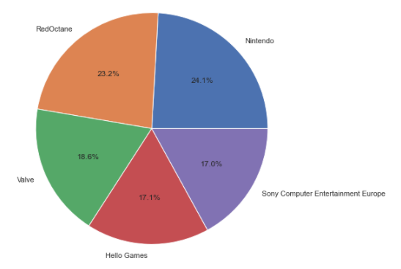
Genre
Platform
Publisher

Slide 32
POPULARITY unknown year
This Photo by Unknown author is licensed under CC BY-SA-NC.

Slide 33
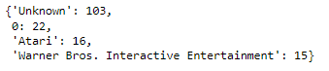
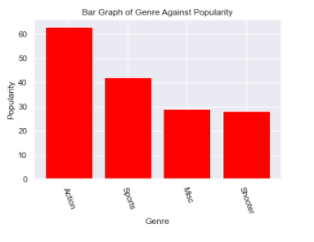
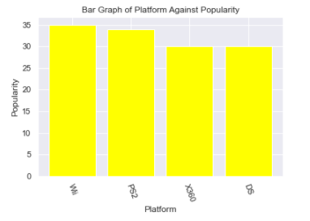
Publisher
Genre
Platform

Slide 34
AVERAGE OVERALL SALES
unknown
This Photo by Unknown author is licensed under CC BY-SA-NC.

Slide 35
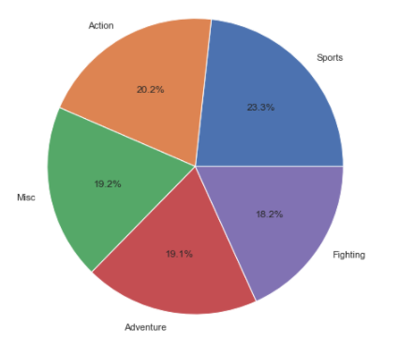
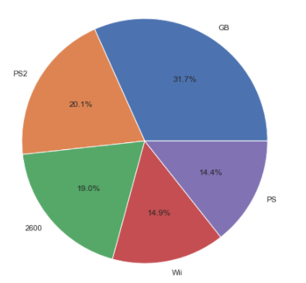
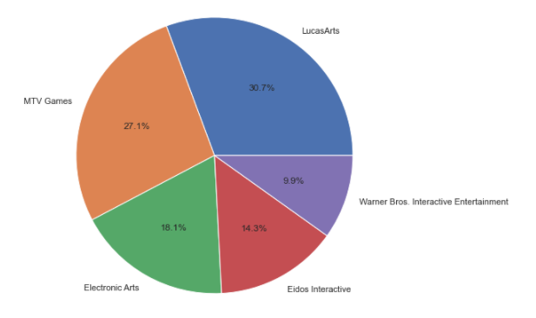
Genre
Platform
Publisher

Slide 36

DEDUCTIONS AND CONCLUSION
Does the Hypothesis apply Here

Slide 37

DEDUCTIONS
Absence of correlation between popularity and Average_Global_Sales in all dependencies
This might be due to specifying the whole Continent as one using the Global_Sales
And Might also be due to finding the Average of the Global Sales per Dependency (Type of Genre, Publisher and Platform)
This Photo by Unknown author is licensed under CC BY.

Slide 38

CONCLUSION
The data_set does not satisfy our hypothesis
As such, though popularity can affect demand, it should not always be used as a primary condition for the selling of gaming products
This Photo by Unknown author is licensed under CC BY-ND.

